Slide 1
Day 2 Homework 2: Where are the jobs?
Search the following popular job websites that you are interested in, for top TWO job opportunities of your choice. Pay special attention to the job requirement, location and salary. You will be asked in class tomorrow about your choices and reasons (The Chinese site has more opportunities than the English one).
https://www.careerengine.org/ (in English)
http://www.zhaopin.com (中文)

Slide 2
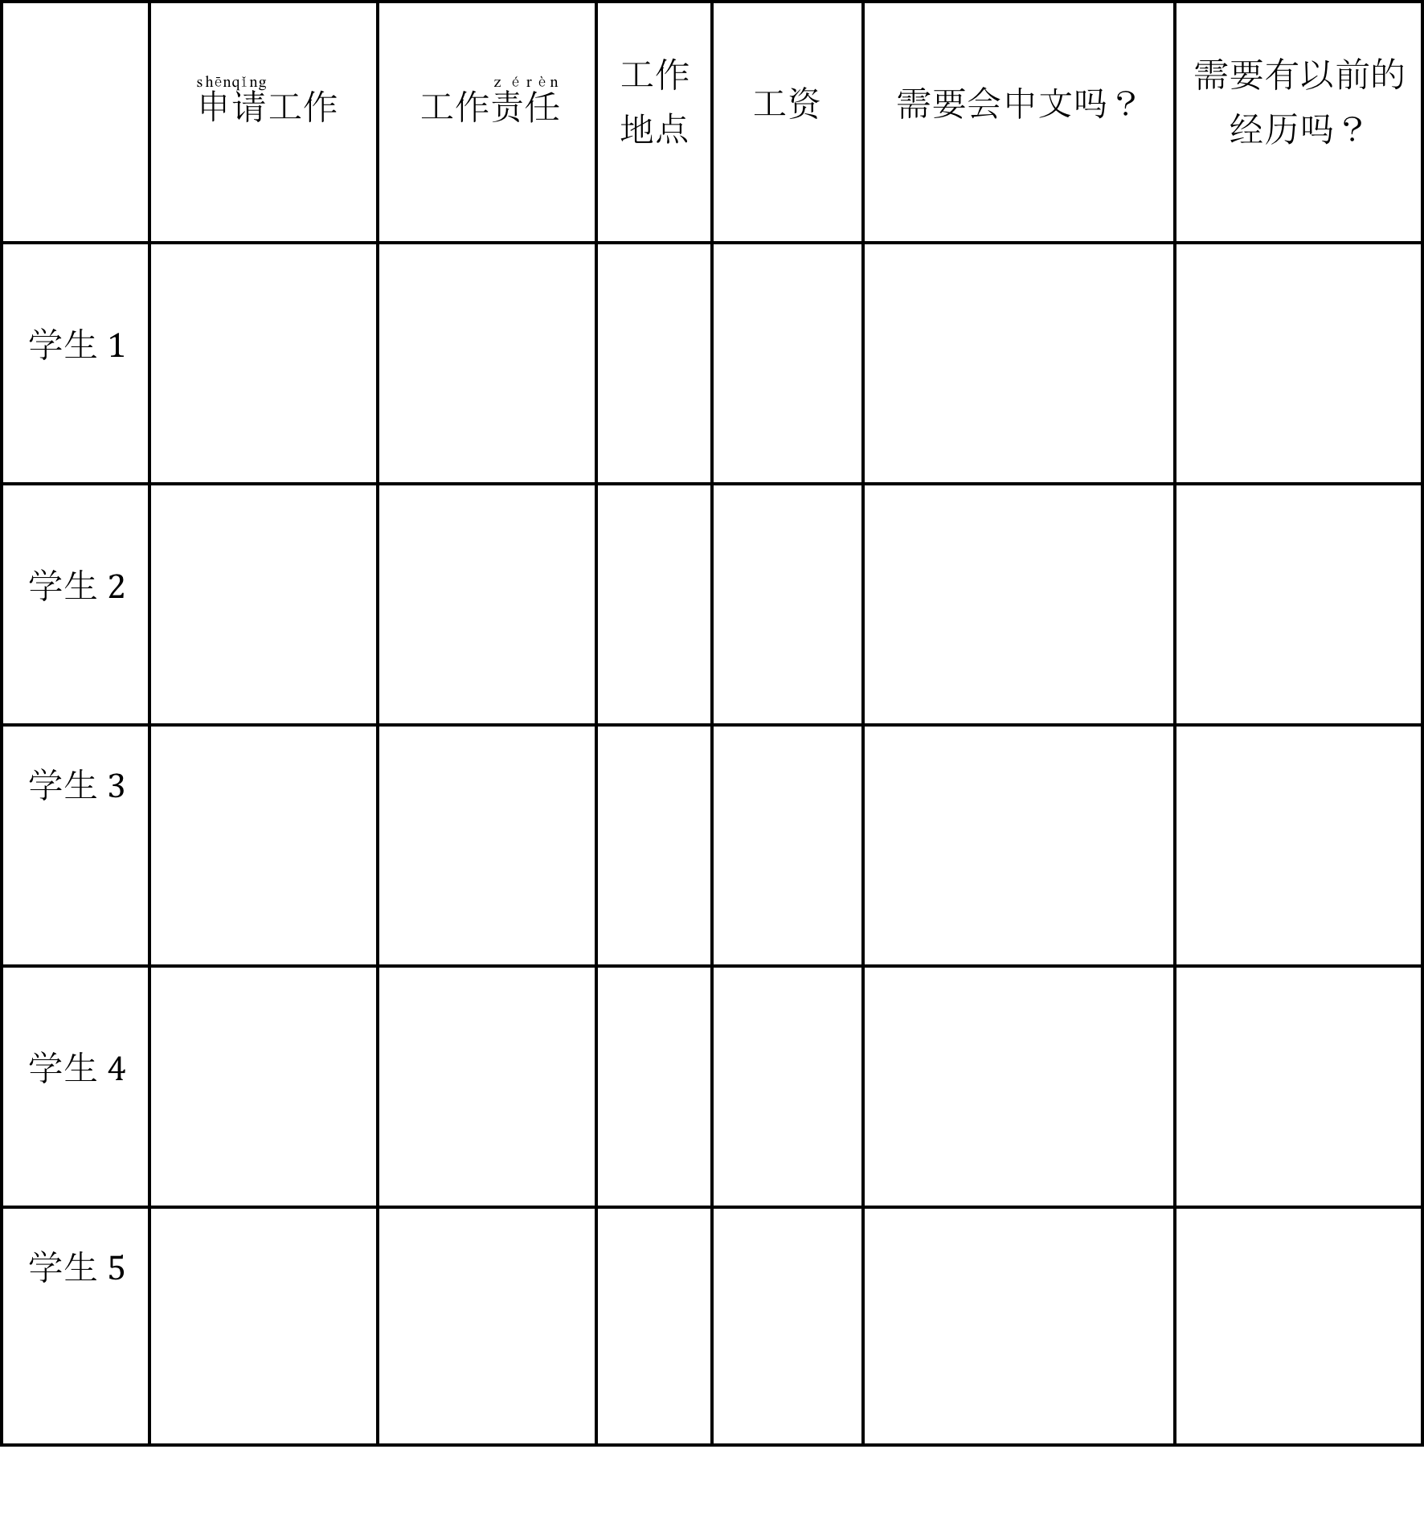
Day 3 Activity 4
Your Dream Job
Interview your classmates, and find out what kind of jobs they are interested in and why.
Let’s vote for the top four job opportunities.

